Slide 1
What is Git?
Version Control System

Slide 2
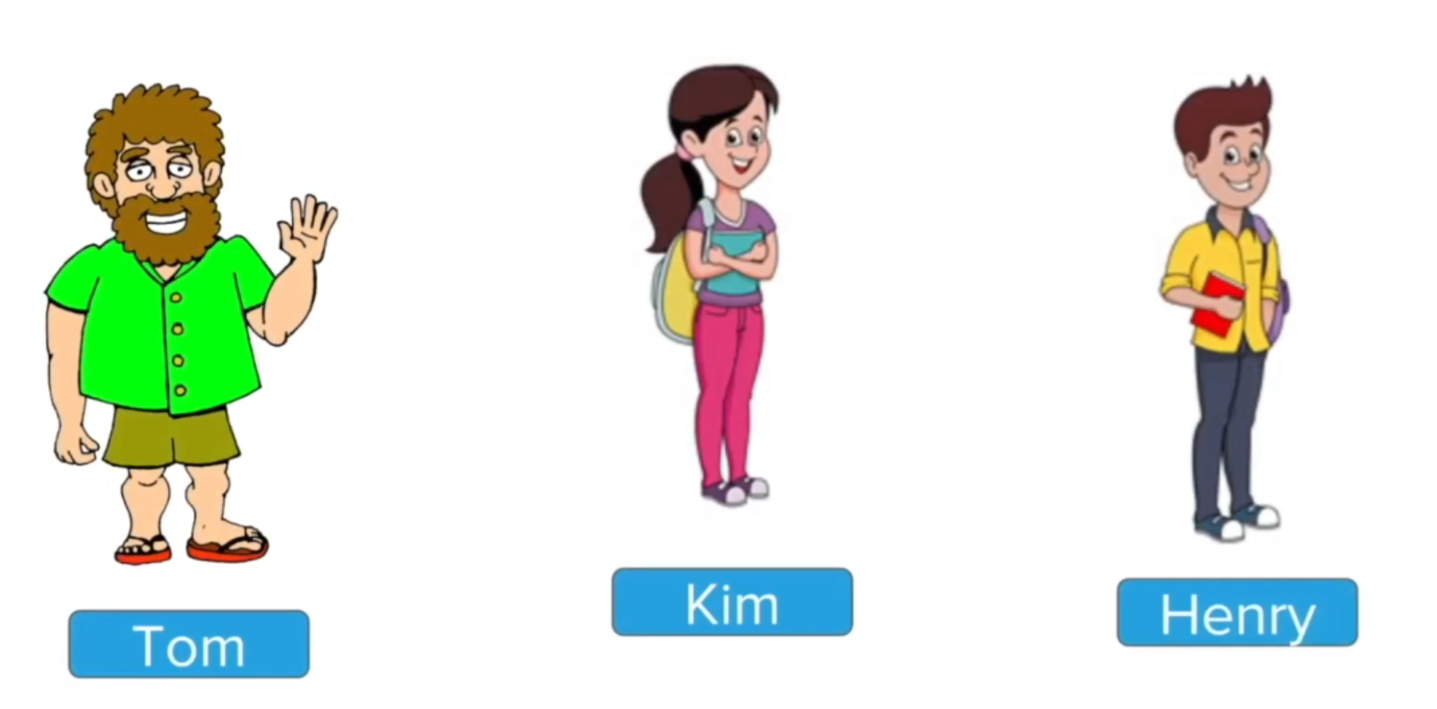

Slide 3
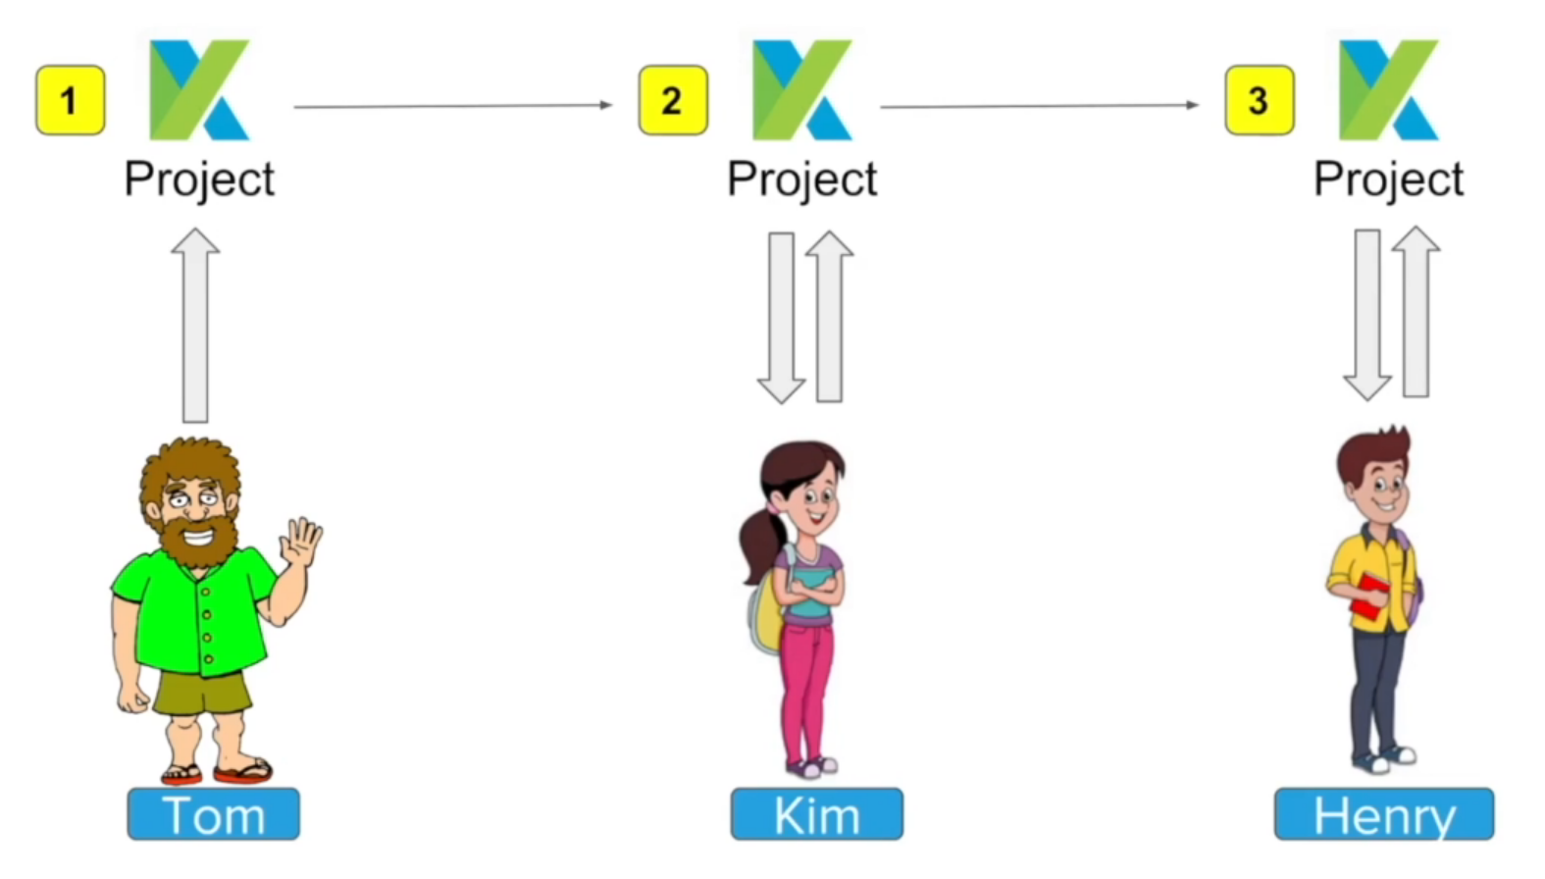

Slide 4
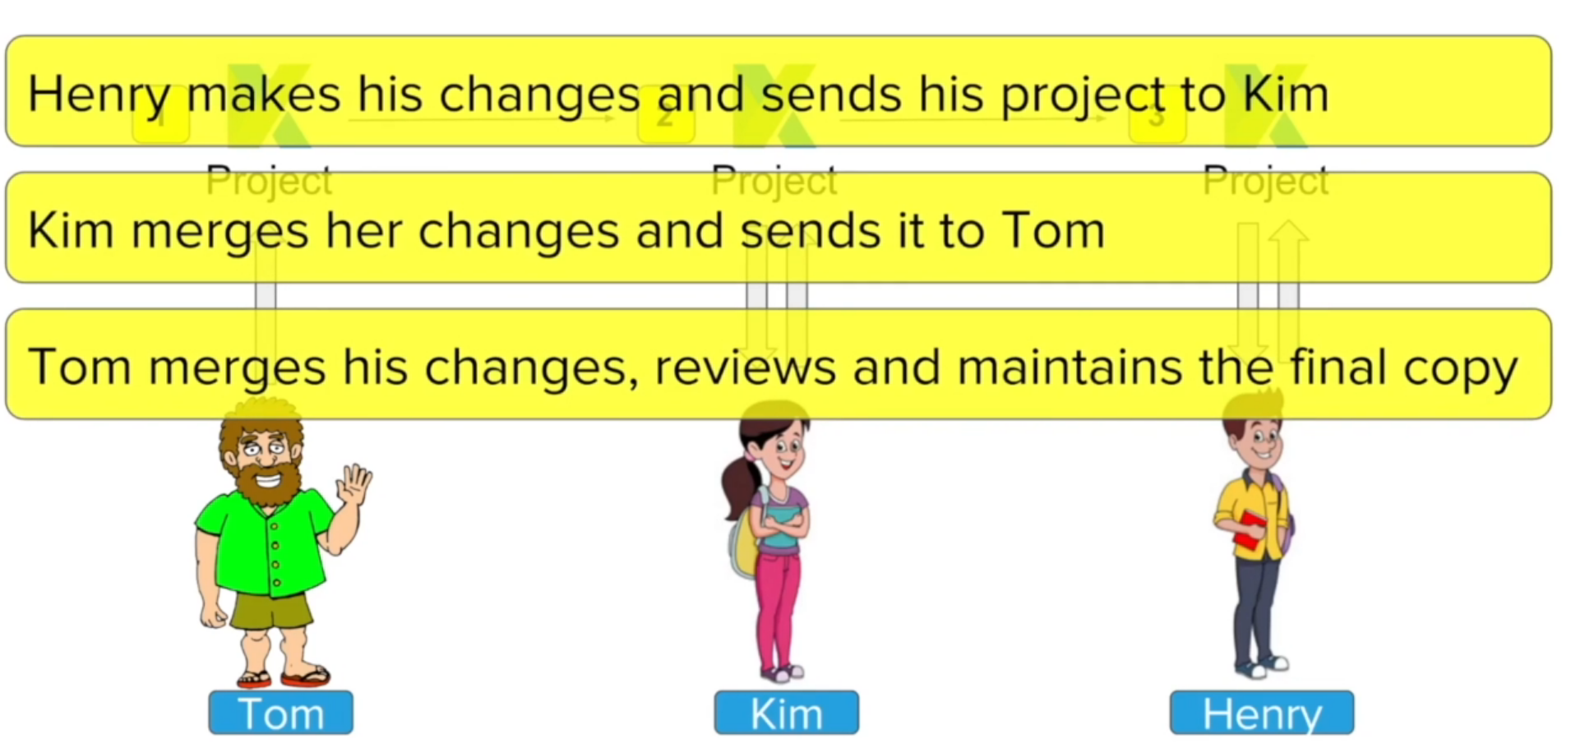

Slide 5
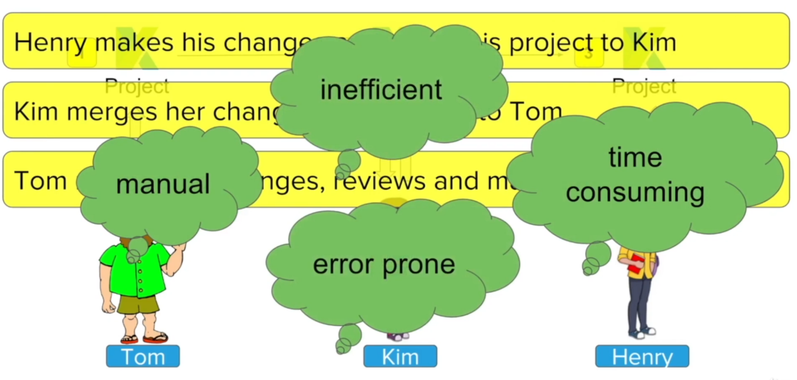

Slide 6
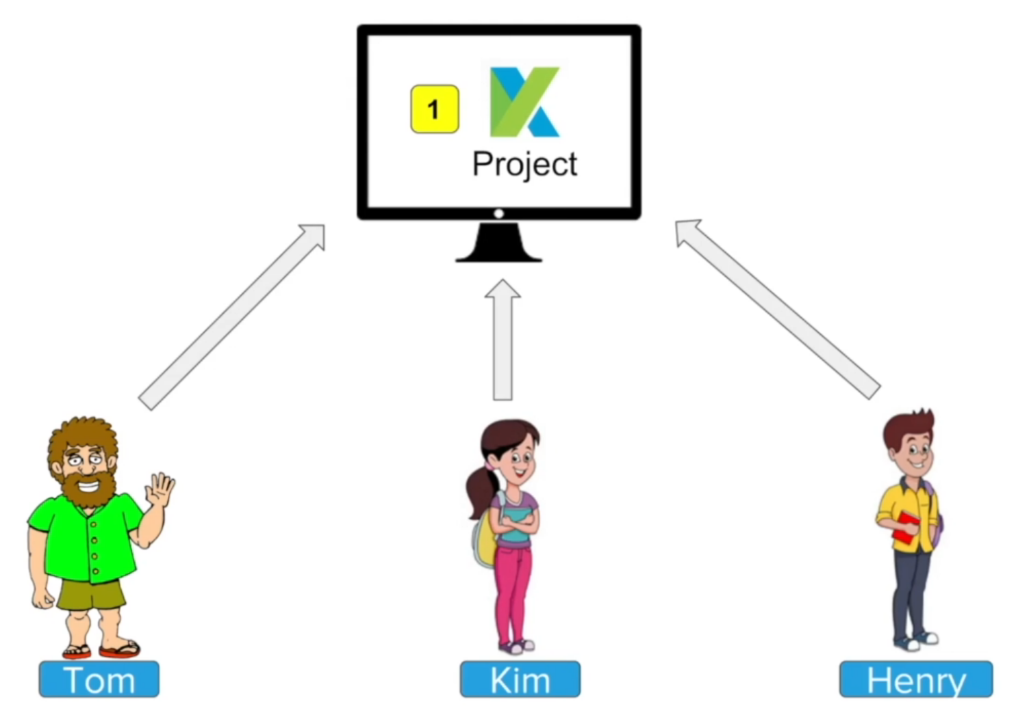

Slide 7
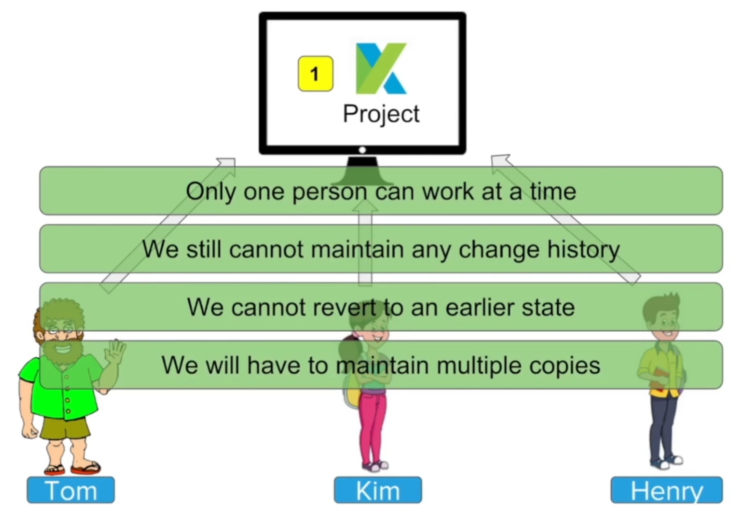

Slide 8
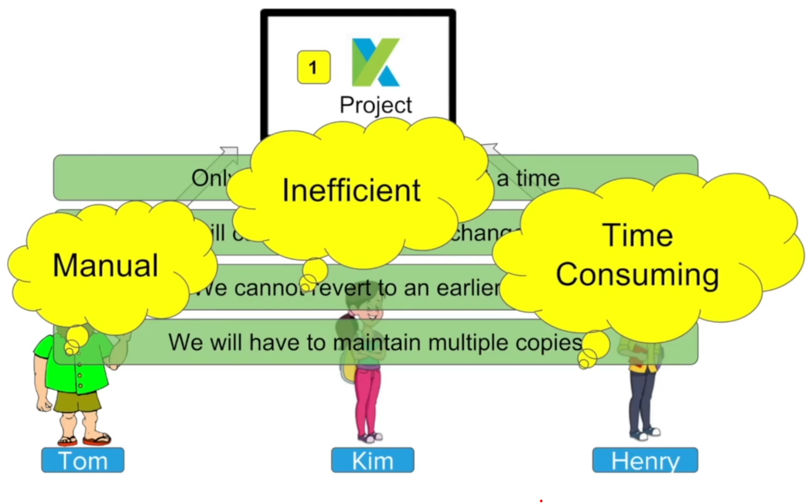

Slide 9
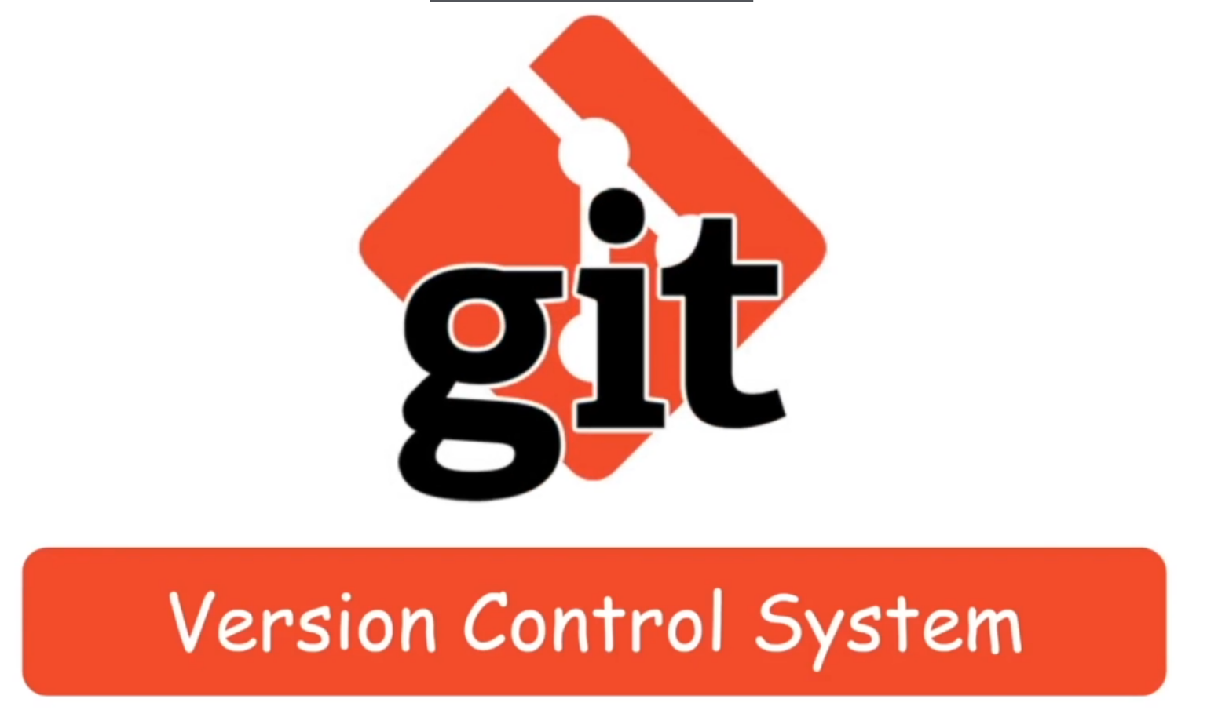

Slide 10
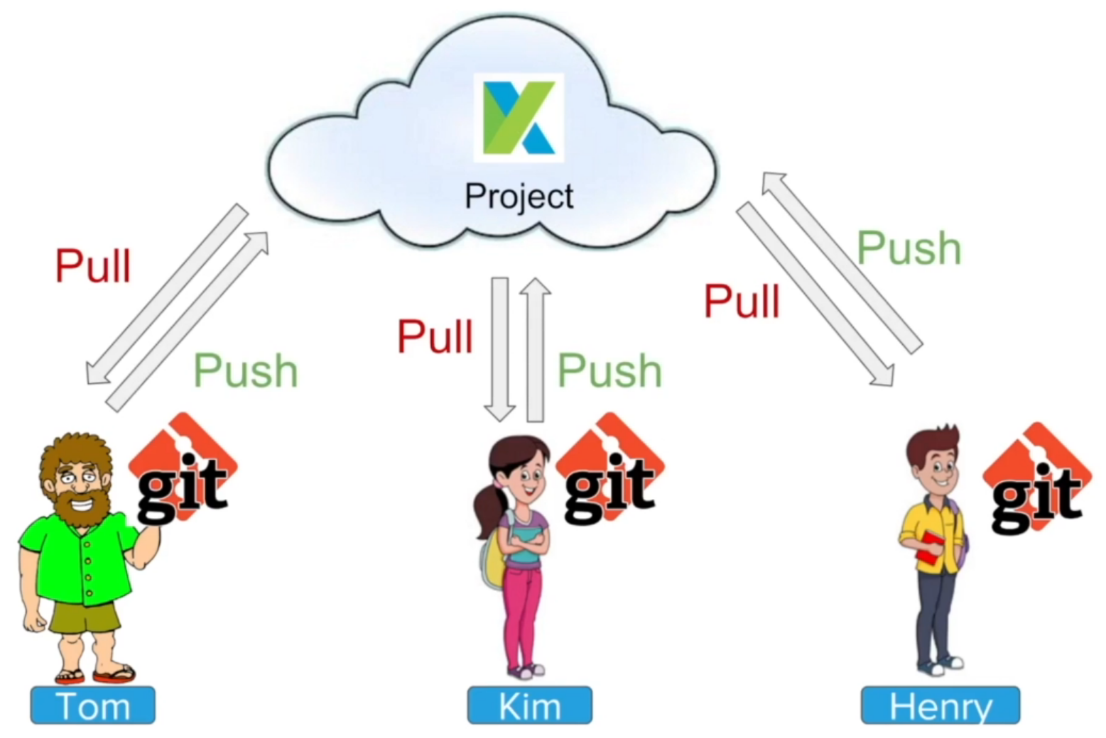

Slide 11
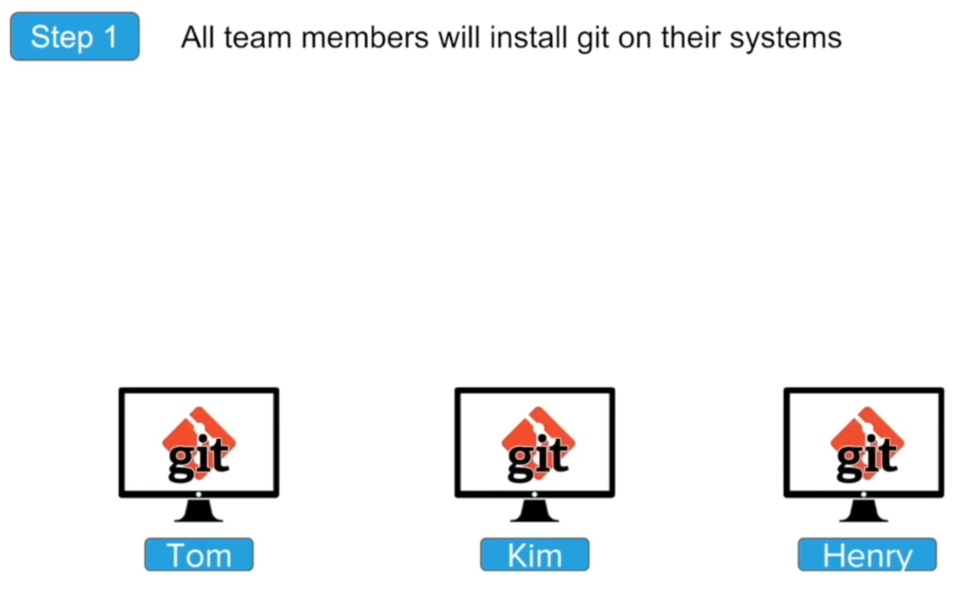

Slide 12
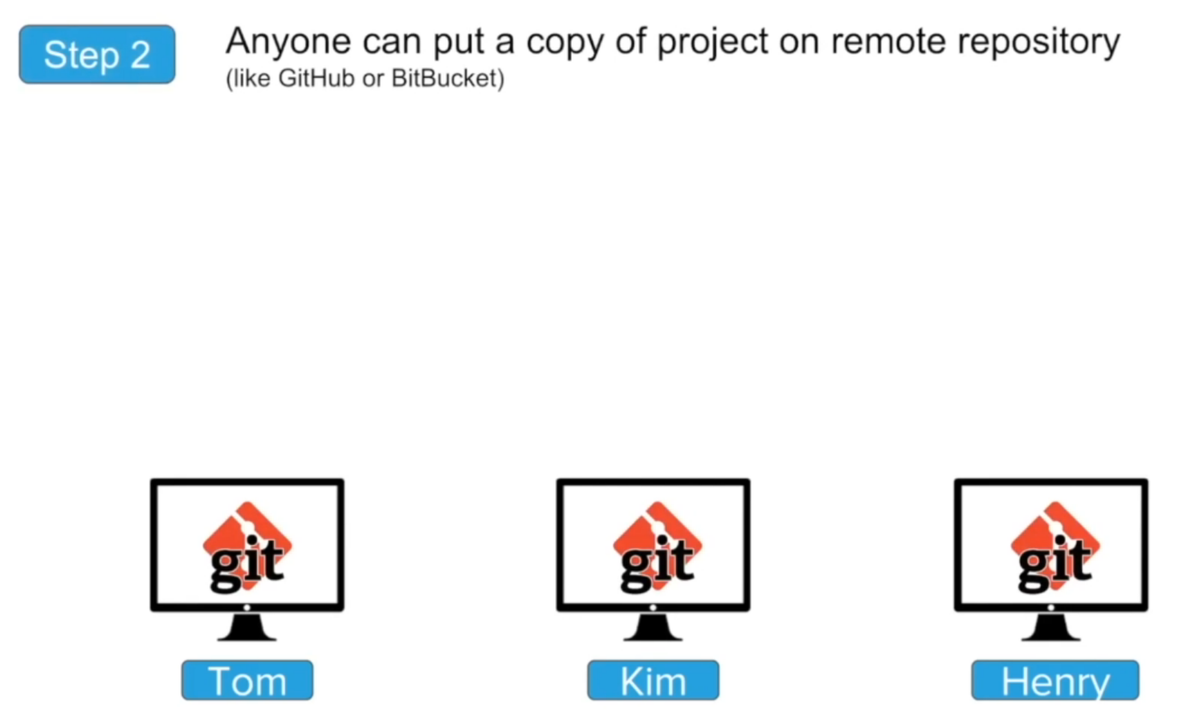

Slide 13
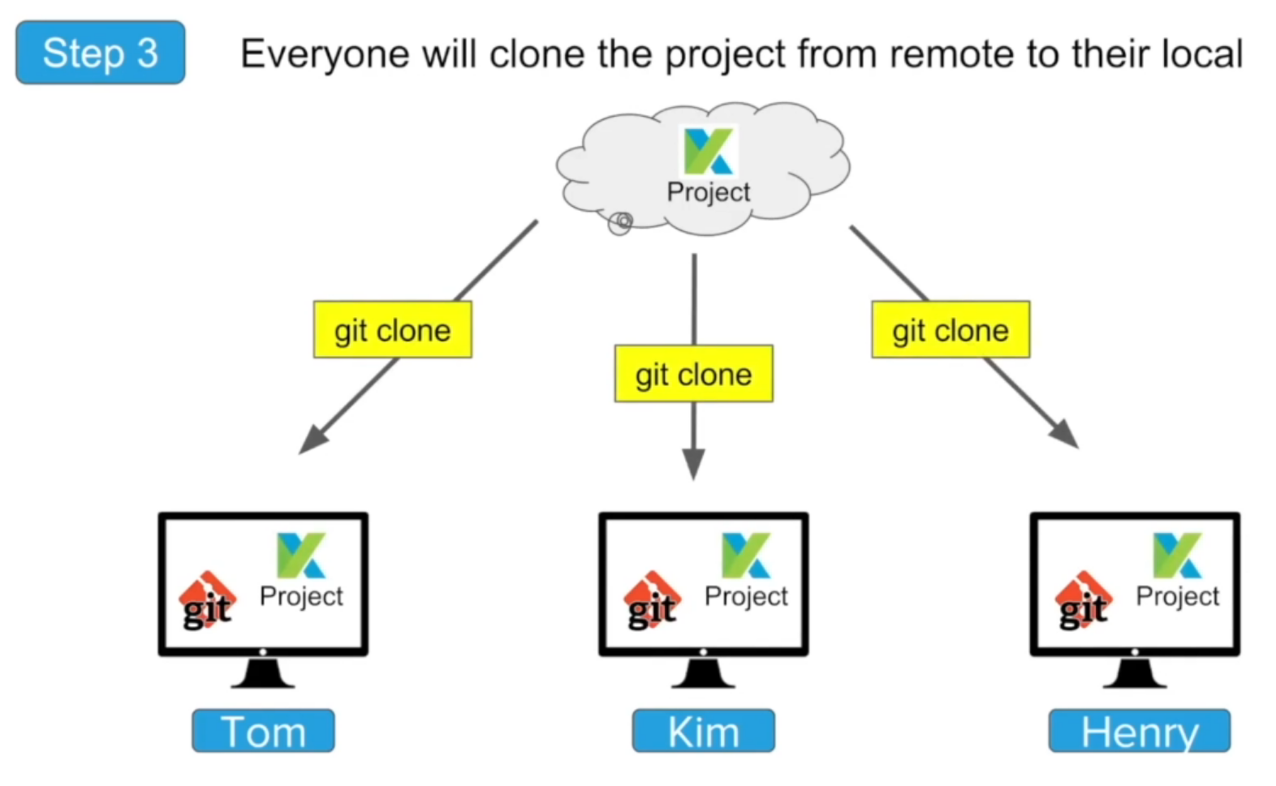

Slide 14
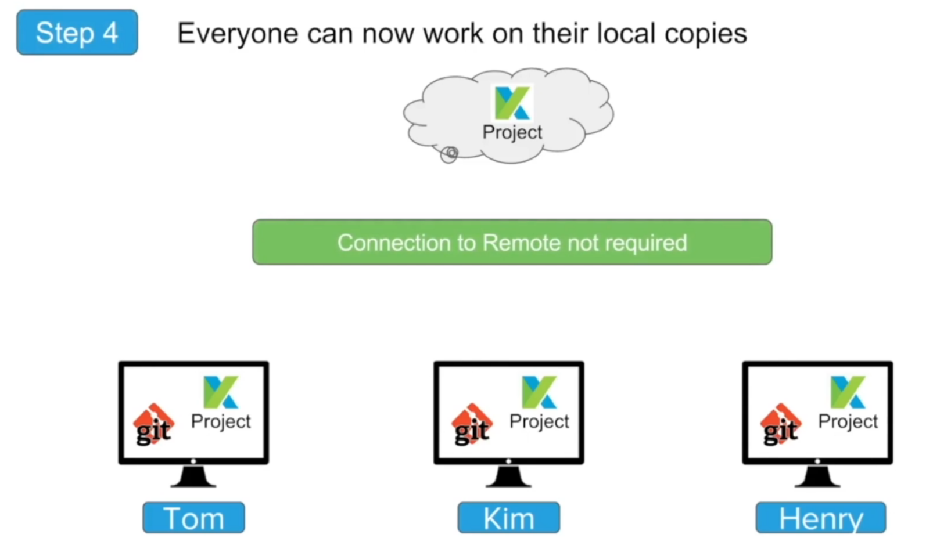

Slide 15
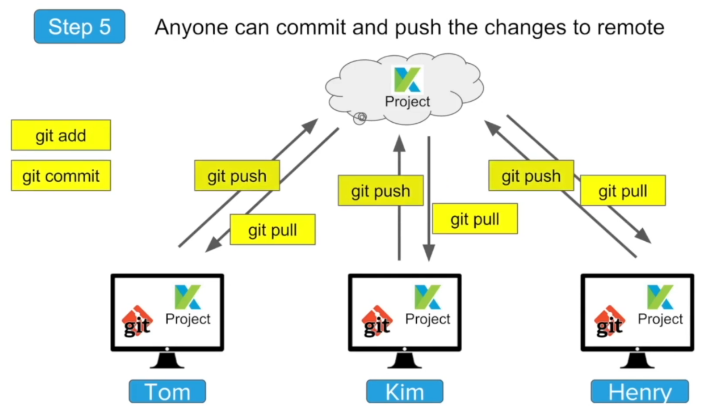

Slide 16
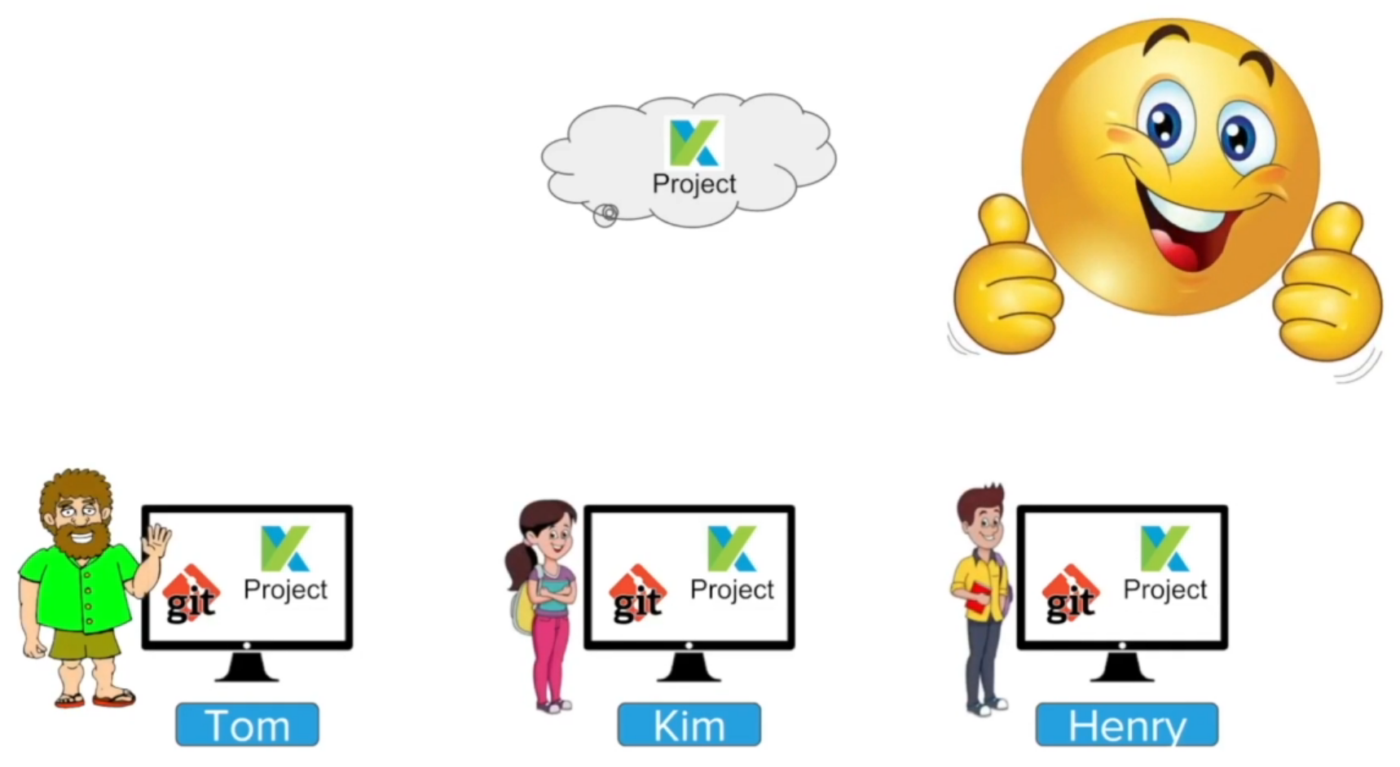

Slide 17
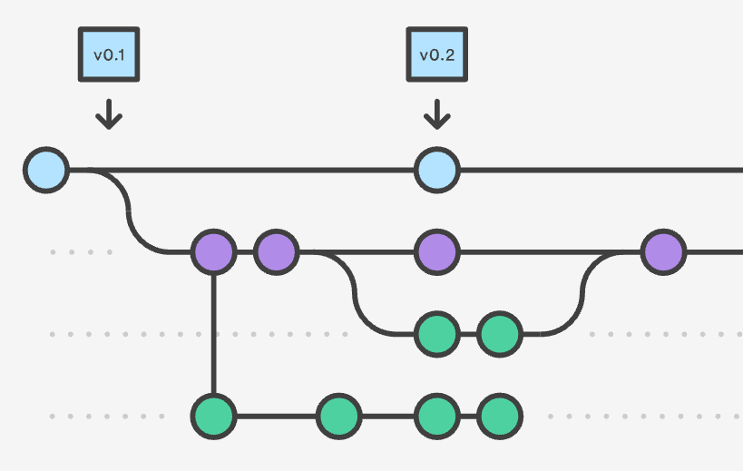
Version control or Source Control
Source control, or version control, is a way of tracking your files progress over time.
It is usually saved in a series of snapshots and branches, which you can move back and forth between.

Slide 18
What’s a version control system?
A version control system, or VCS, tracks the history of changes as people and teams collaborate on projects together.
As the project evolves, teams can run tests, fix bugs, and contribute new code with the confidence that any version can be recovered at any time.
Developers can review project history to find out:
What changes were made?
Who made the changes?
When were the changes made?
Why were changes needed?

Slide 19

What you can do
Version control allows you to:
Distribute your file changes over time
Prevent against data loss/damage by creating backup snapshots
Manage complex project structures

Slide 20
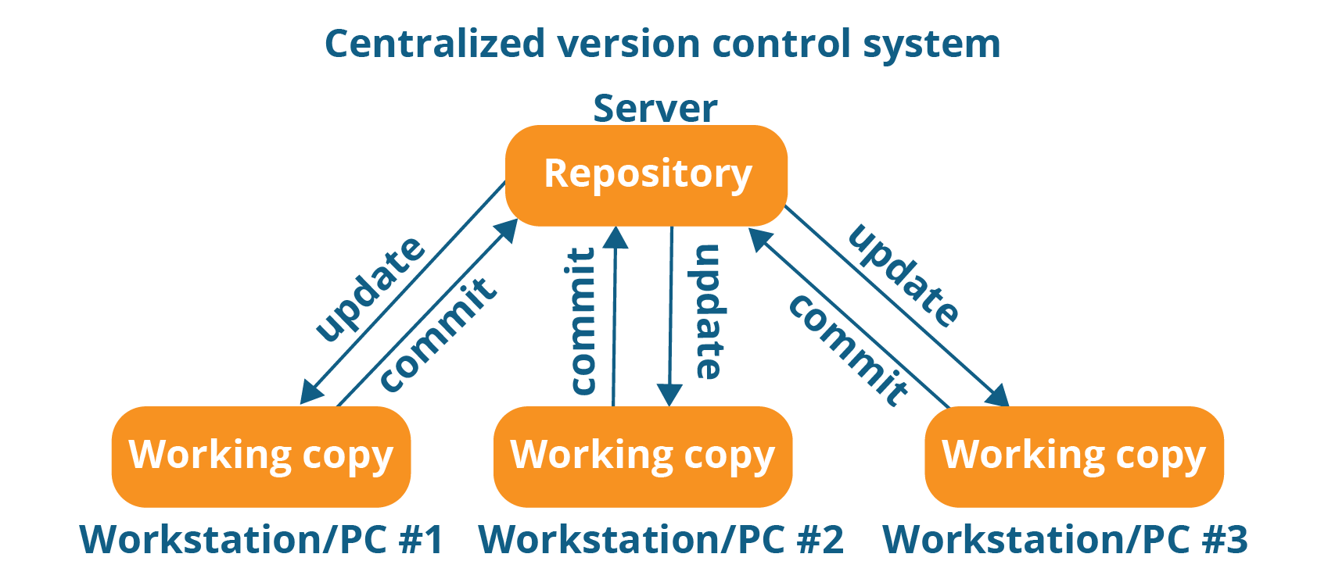
Centralized vs Distributed Version Control Systems
There are two general varieties of version control: centralized and distributed.
Centralized version control systems are based on the idea that there is a single “central” copy of your project somewhere (probably on a server), and programmers will “commit” their changes to this central copy.
“Committing” a change simply means recording the change in the central system. Other programmers can then see this change.

Slide 21
Centralized Version Control System
Some of the most common centralized version control systems are Subversion (or SVN) and Perforce.
Main benefits:
Centralized systems are typically easier to understand and use
You can grant access level control on directory level
performs better with binary files

Slide 22
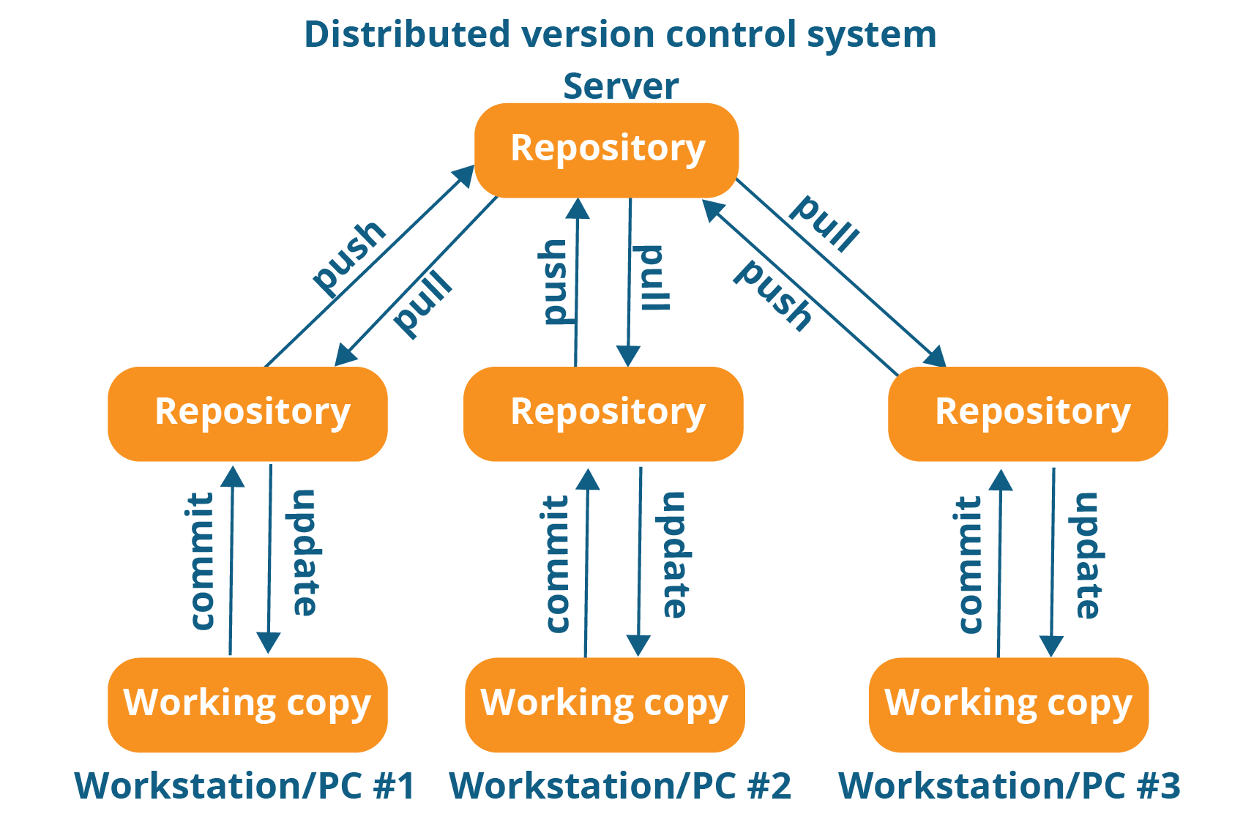
Distributed Version Control System
In distributed version control, every developer “clones” a copy of a repository and has the full history of the project on their own hard drive. This copy (or “clone”) has all of the metadata of the original.
The act of getting new changes from a repository is usually called “pulling,” and the act of moving your own changes to a repository is called “pushing”.
The three most popular of these are Git, Mercurial, and Bazaar.
Main benefits:
Performance of distributed systems is better
Branching and merging is much easier
With a distributed system, you don’t need to be connected to the network all the time (complete code repository is stored locally on PC)

Slide 23
About Git
Git is a Version control software, similar to many others out there.
It follows all the same rules and concepts that any version control follows.

Slide 24

Why use Git?
The most popular version control software in the world.
According to the latest Stack Overflow developer survey, more than 70 percent of developers use Git, making it the most-used VCS in the world.
Lots of documentation and support.
Lots of integration with other applications (SourceTree, Heroku, GitHub).
Git is commonly used for both open source and commercial software development, with significant benefits for individuals, teams and businesses.

Slide 25
Git vs GitHub

Slide 26

What GitHub Is
GitHub is an application allowing you to store remote repositories. (it’s in the name!)
You can interact with your GitHub repository through the push/pull system on your local machine.
GitHub is used primarily to allow other people to add to the project (ex. Open source projects)
GitHub allows more people than just yourself to see and interact with the repository.

Slide 27
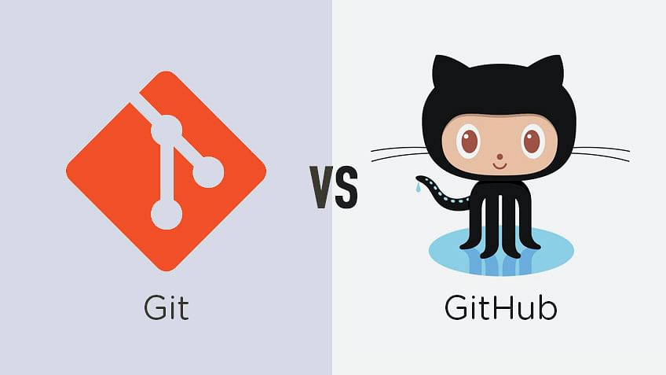
The Difference
Git is a version control software allowing you to take snapshots and distribute your creations & modifications over time.
GitHub is an application allowing you to store and interact with your repository on a remote server, as well as adding more features (eg. Publicity, licensing, collaborators)
Git is the bones and flesh of version control, while GitHub gives you the platform to work with your repository easier.

Slide 28
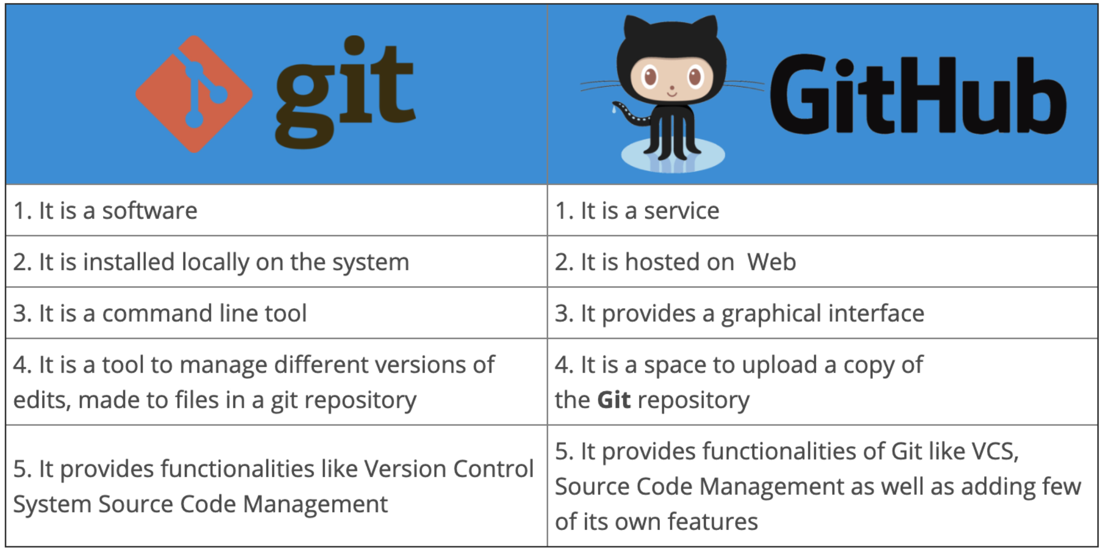

Slide 29
Git Workflow

Slide 30

Introduction
Before Git tracks a change, it goes through a long chain of operations and tasks.
Many of these tasks are user controlled, and are required for changes to be tracked correctly.

Slide 31
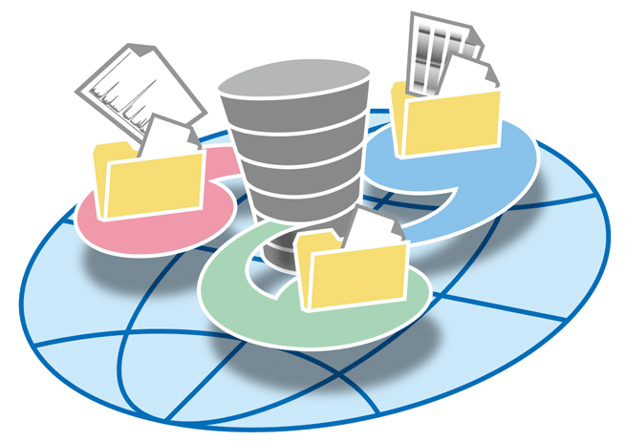
Repositories
Repositories, usually called ‘repos’, store the full history and source control of a project.
They can either be hosted locally, or on a shared server, such as GitHub.
Most repositories are stored on GitHub, while core contributors make copies of the repository on their machine and update the repository using the push/pull system.
Any repository stored somewhere other than locally is called a ‘remote repository’.

Slide 32
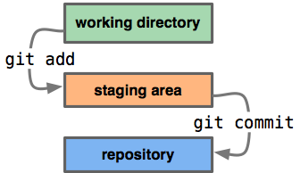
Repos vs Directories
Repositories are timelines of the entire project, including all.
Directories, or ‘working directories’ are projects at their current state in time.
Any local directory interacting with a repository is technically a repository itself, however, it is better to call these directories ‘local repositories’, as they are instances of a remote repository.

Slide 33
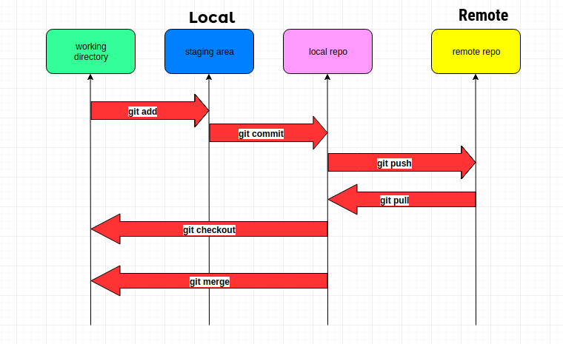
Workflow Diagram

Slide 34
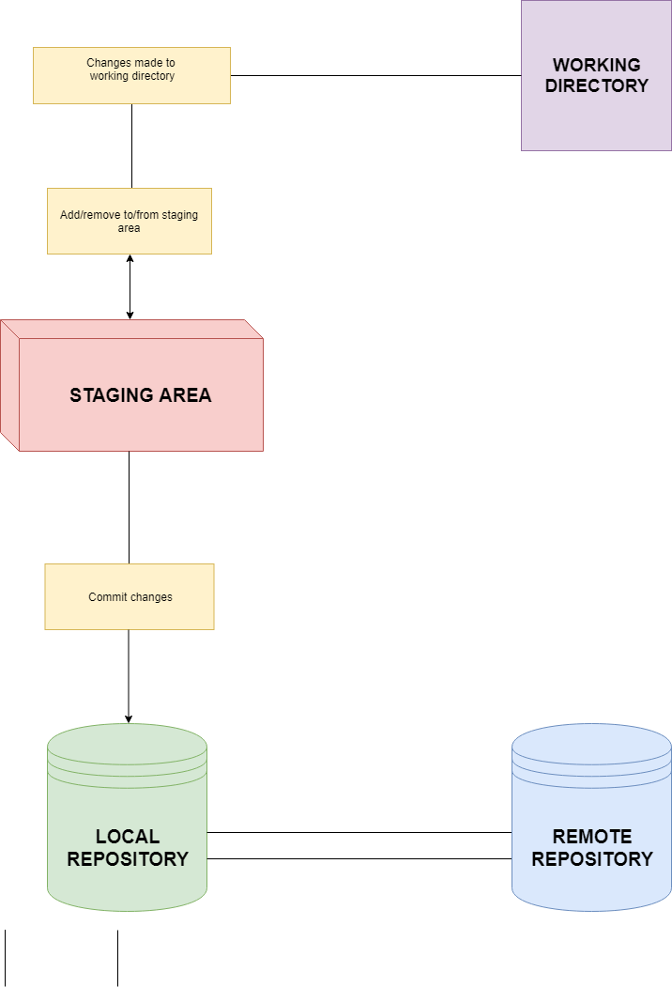
Workflow Diagram
This diagram shows a little bit about how the basic Git workflow process works
The staging area is the bundle of all the modifications to the project that are going to be committed.
A ‘commit’ is similar to taking a snapshot of the current state of the project, then storing it on a timeline.

Slide 35
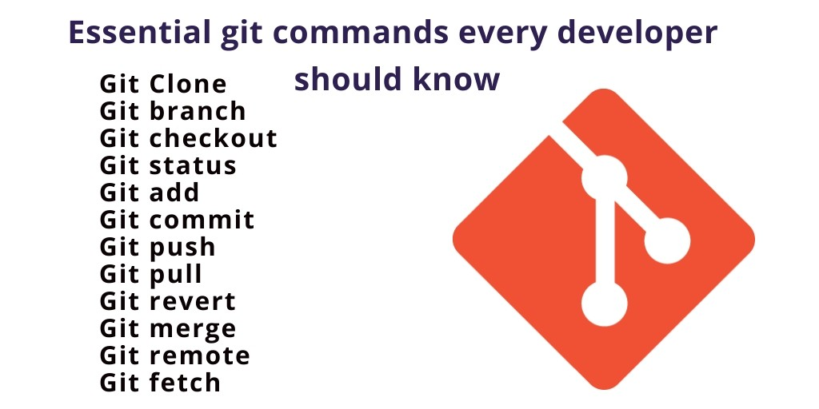
Git Commands
git init : initializes a brand new Git repository and begins tracking an existing directory.
git clone : creates a local copy of a project that already exists remotely.
git add : performs staging, the first part of that two-step process.
git commit : saves the snapshot to the project history and completes the change-tracking process.

Slide 36
Git Commands
git status : shows the status of changes as untracked, modified, or staged.
git branch : shows the branches being worked on locally.
git merge : merges lines of development together. This command is typically used to combine changes made on two distinct branches.
git pull : updates the local line of development with updates from its remote counterpart.
git push : updates the remote repository with any commits made locally to a branch.

Slide 37
Lets get Started!

Slide 38
Commands
Git –version
Pwd
Ls
Ls -l
Ls -al
Clear
Pwd
Cd desktop
Mkdir git project1
Cd project1
Pwd

Slide 39
Commands
Git init
Ls
Touch index.html
Touch styles.css
Touch script.js
Ls
Git status
Echo “practicing first git” > file.txt
Explorer // Now open the file to see the changes
clear

Slide 40
Commands
Ls
Git status
Git add file.txt
Git commit -m “adding initial changes”
Git status

